Slide 1
Module 14 Assignment
File created on: 11/28/2021 9:31:11 AM

Slide 2
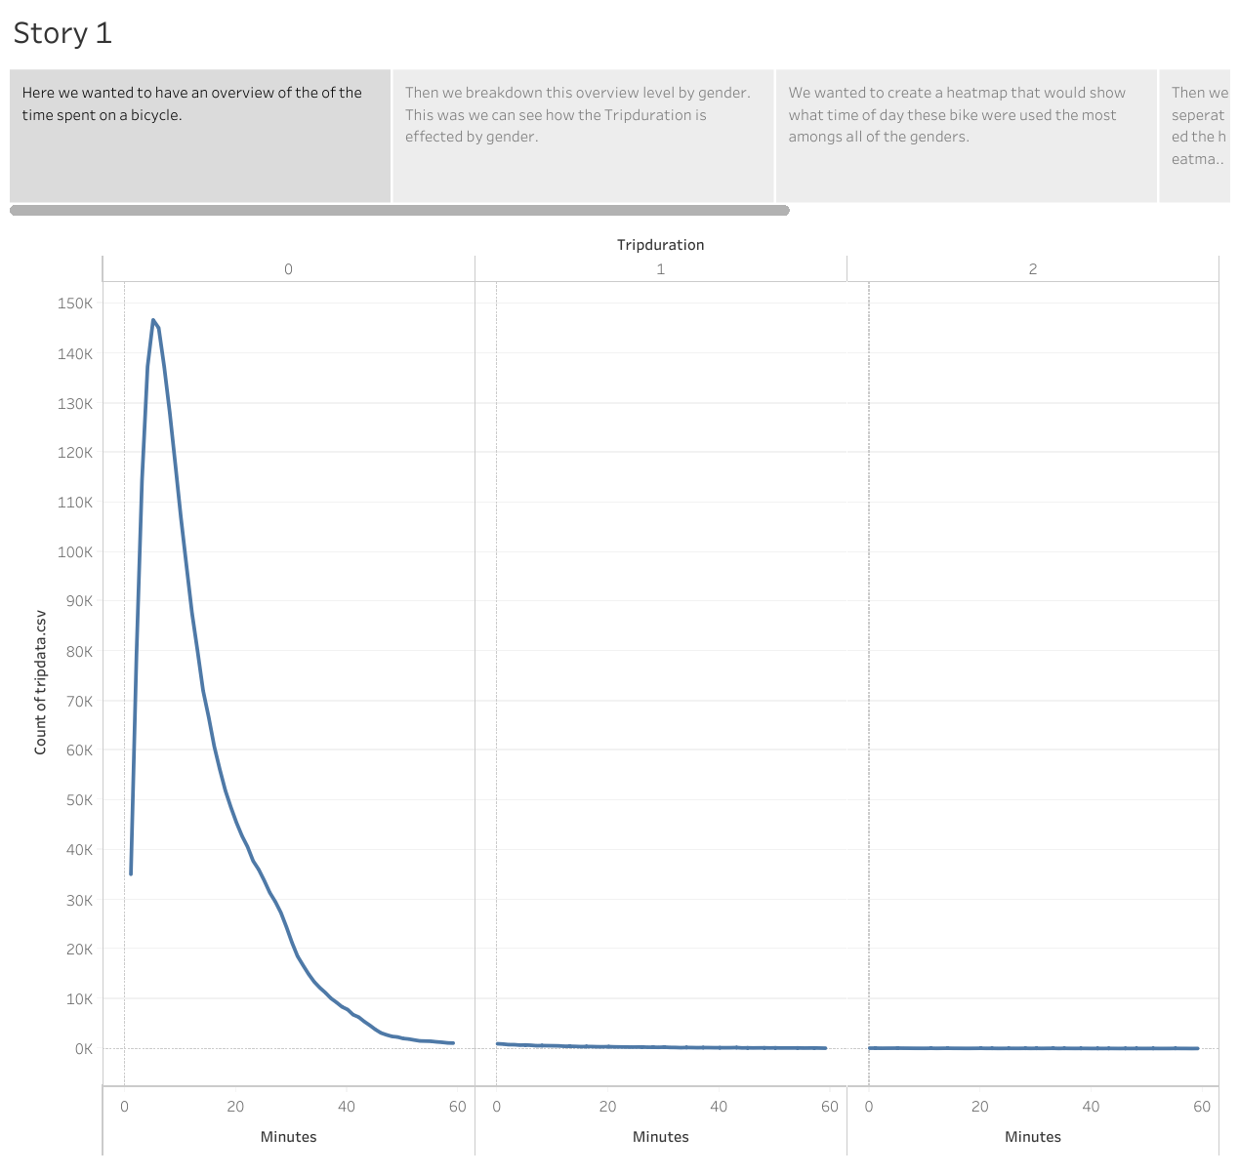

Slide 3
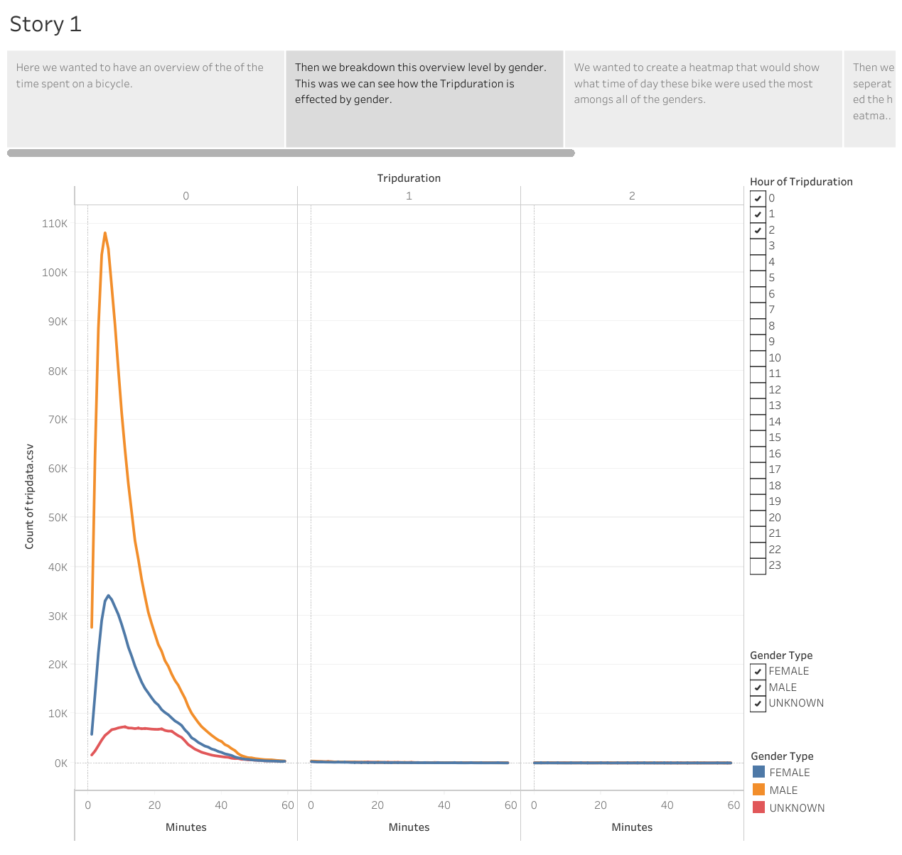

Slide 4
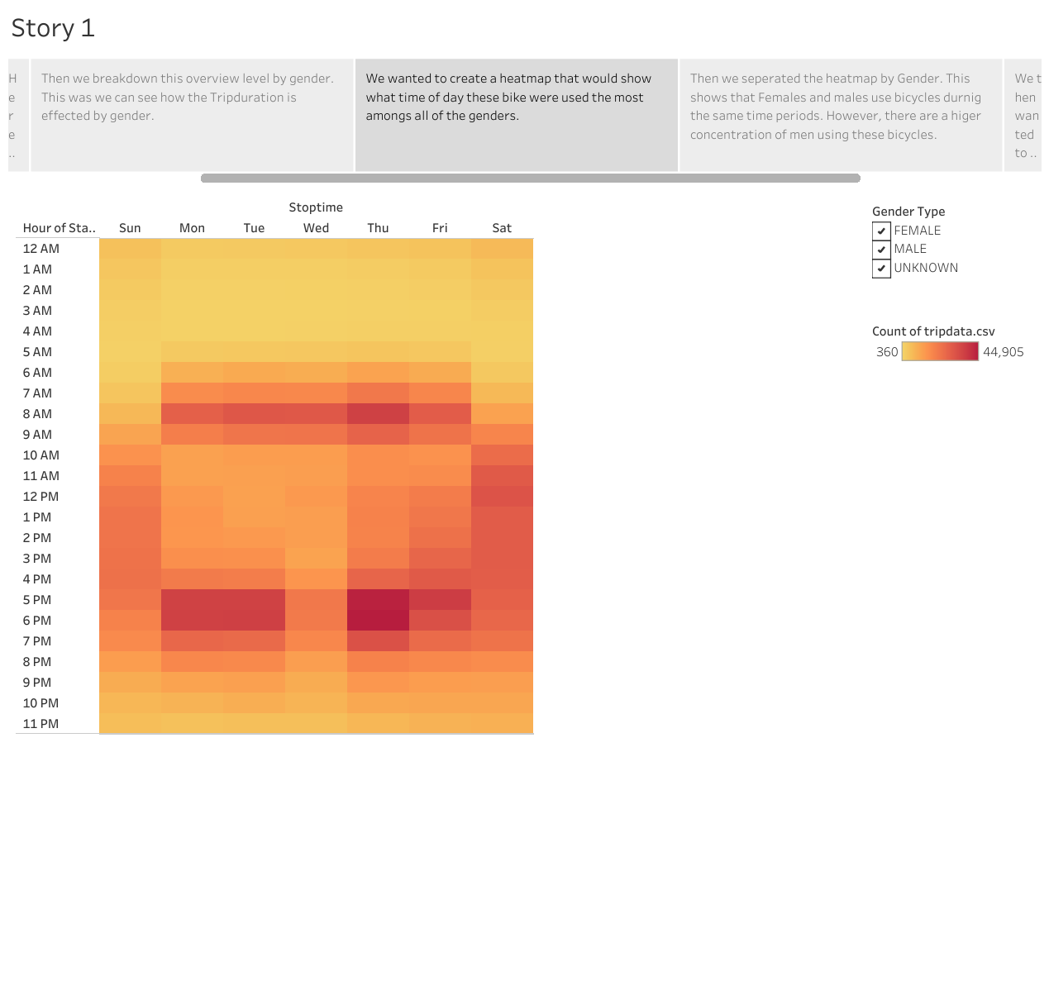

Slide 5
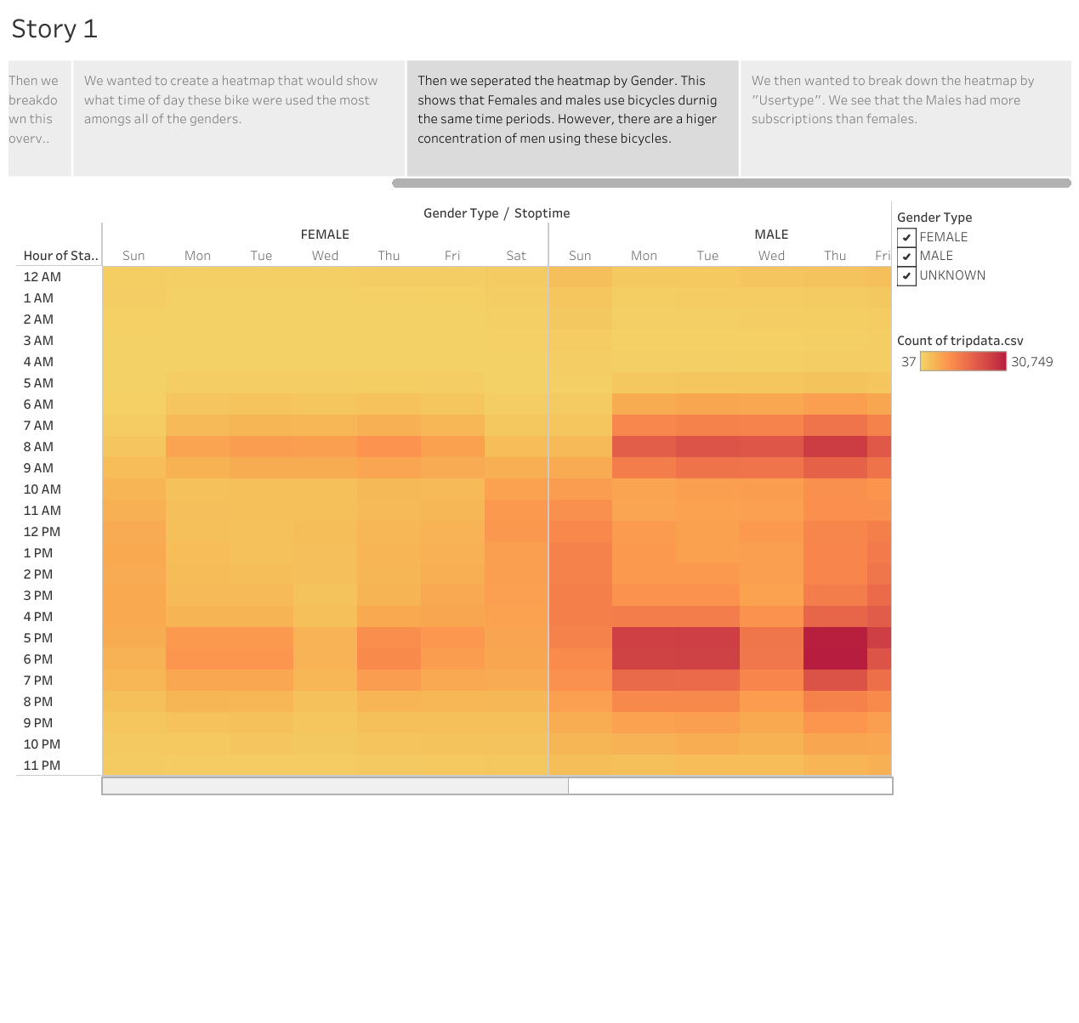

Slide 6
